Slide 1
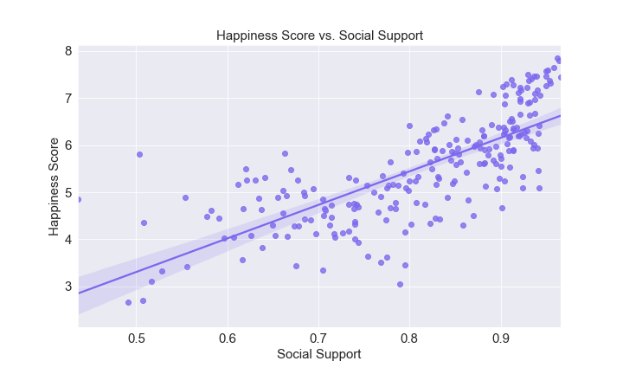
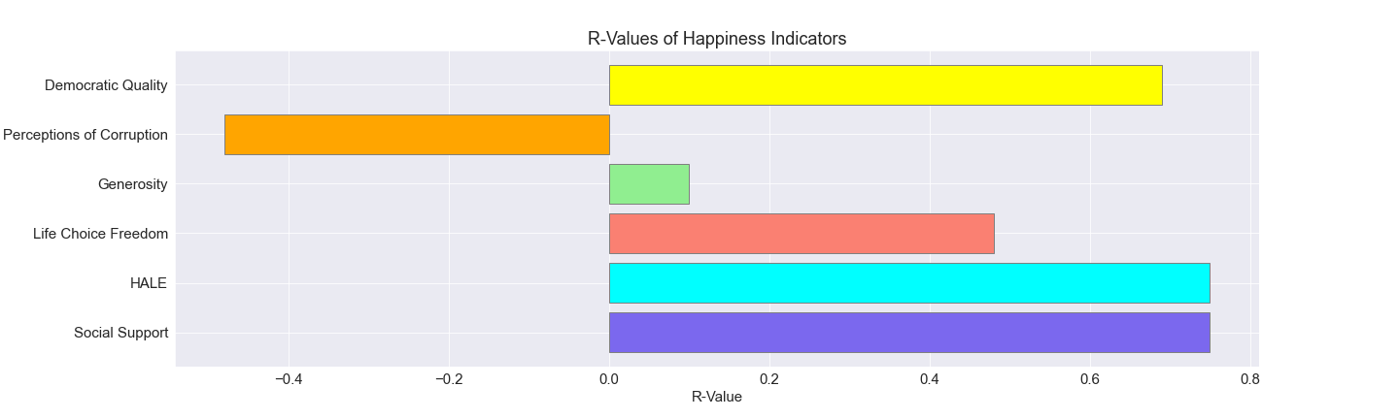

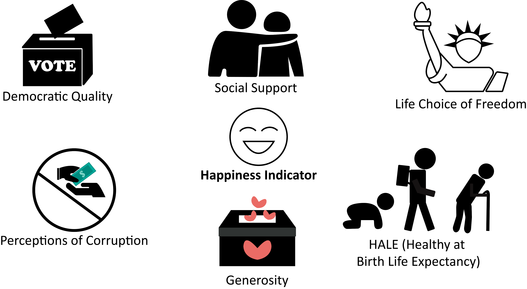
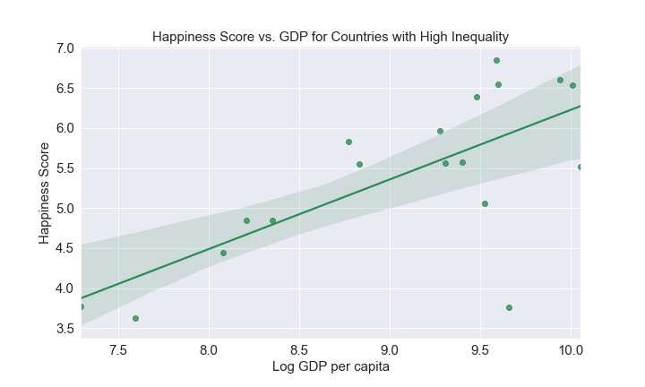
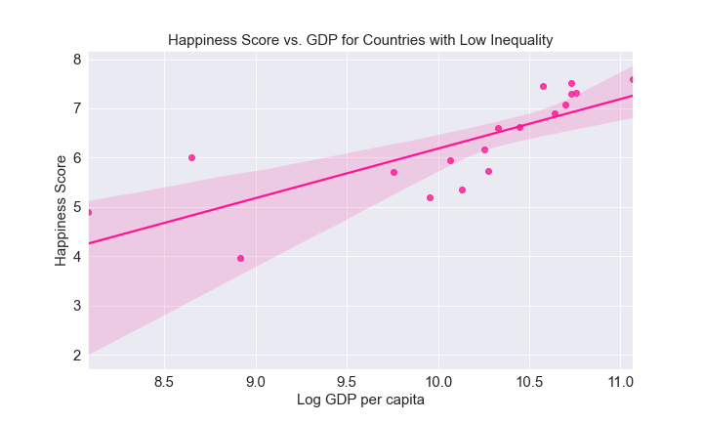
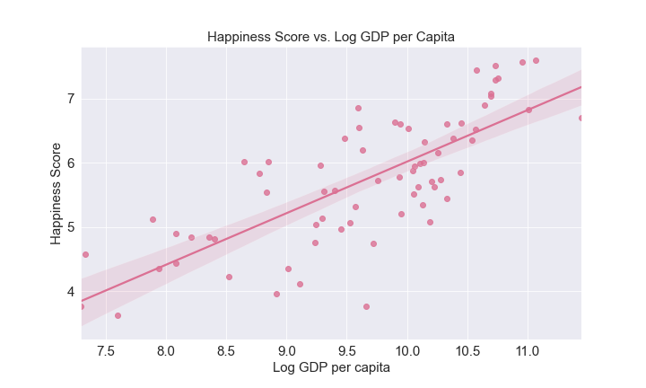
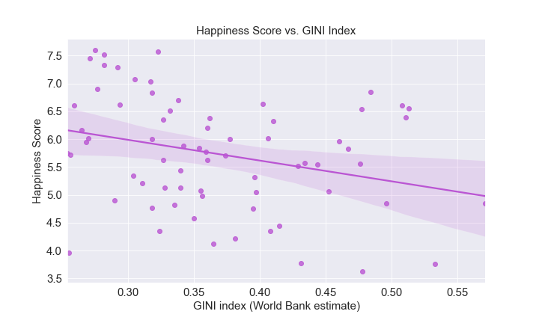
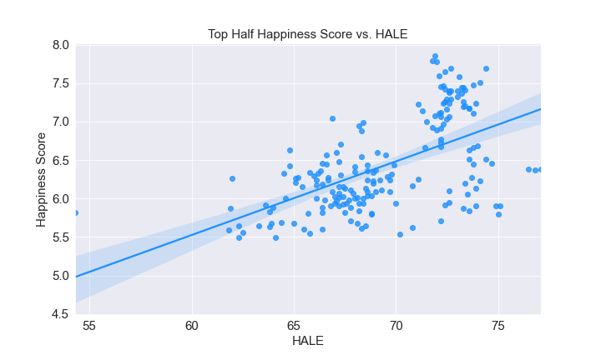
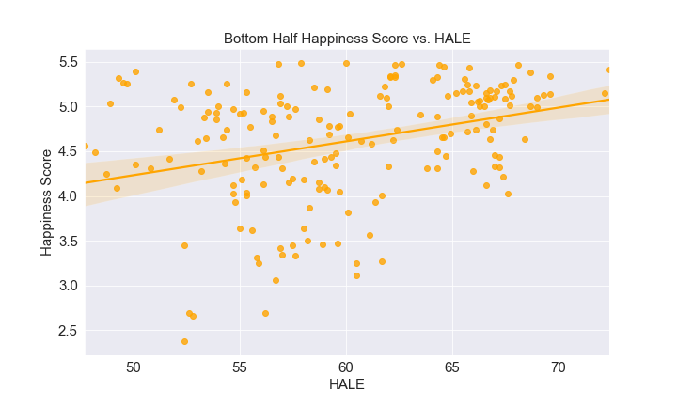

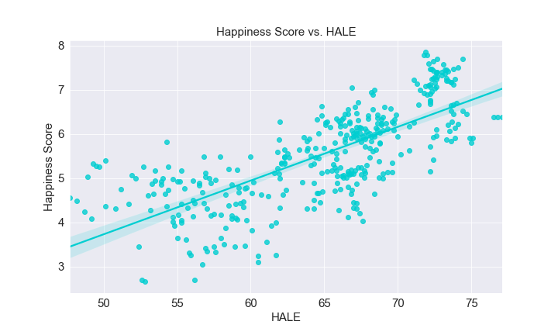
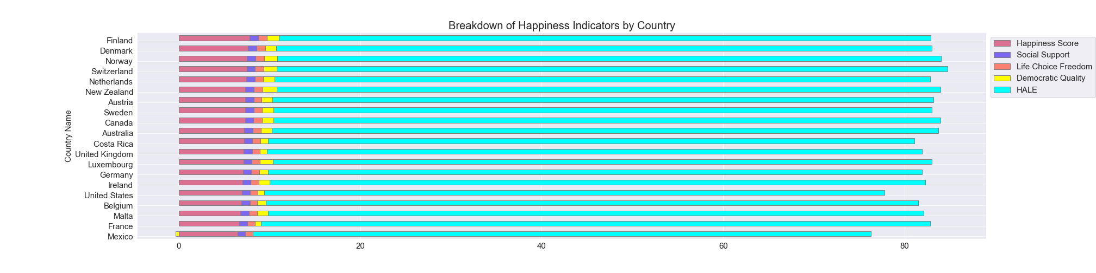
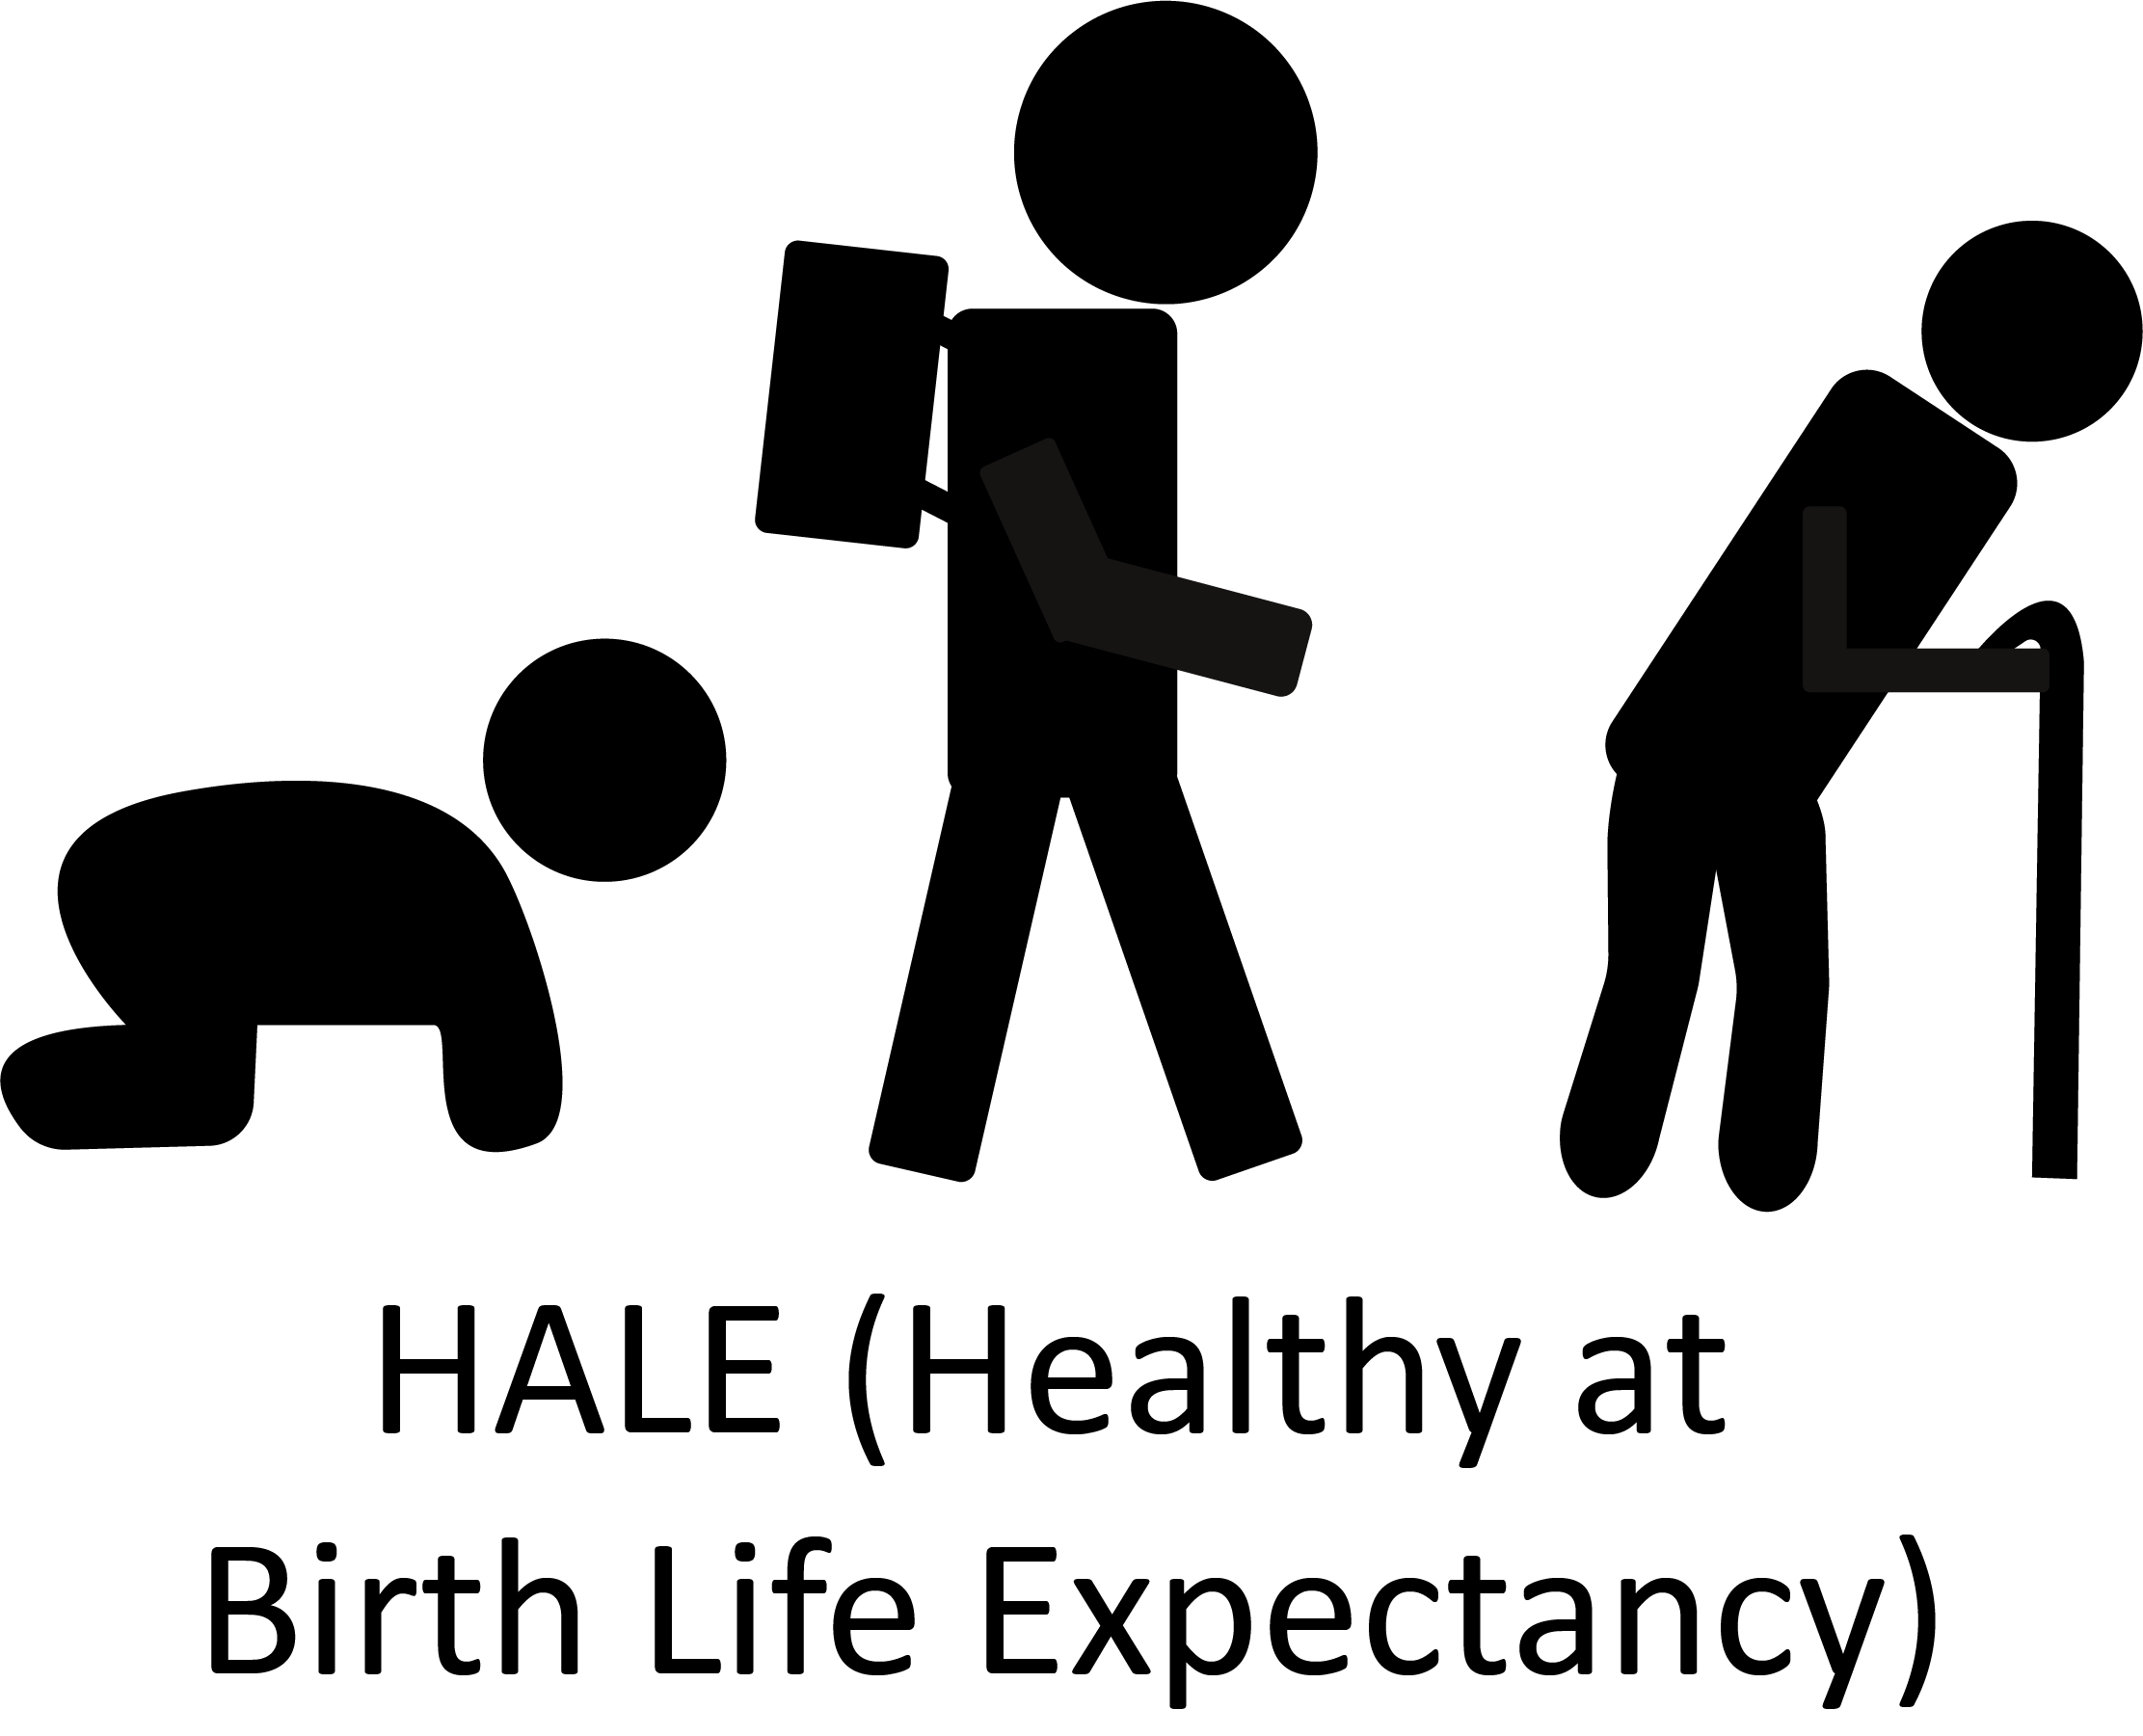
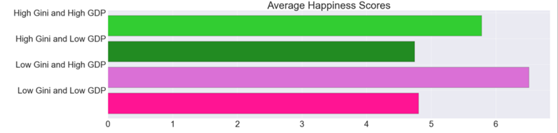


t
G
Happiness vs. GDP for High and Low Gini
Economic Growth or Equality?
Top and Bottom Half Happiness Score vs. HALE
F
E
Does Money Buy Happiness?
An Analysis of The Happiness Index
D
So What?
C
QUESTIONS?
B
A
Gini
GDP
GDP
(Gross Domestic Product)
Gini Index
(Economic inequality)
By: Franklyn De La Cruz, JJ Krehbiel, Tristan Nguyen, Mihee Park, Shae Stringer-Jones, Maria Valdes
Q

